Slide 1
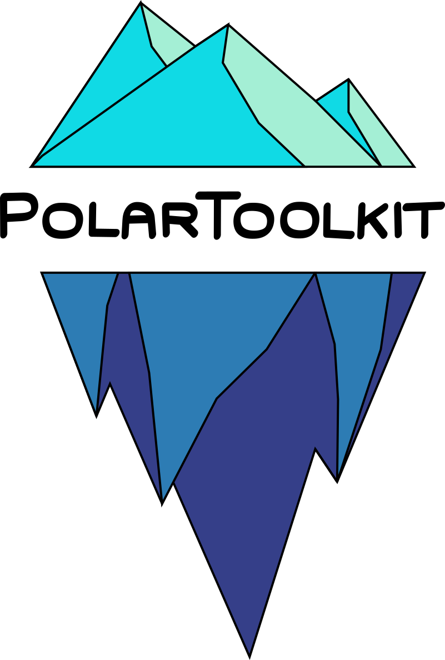
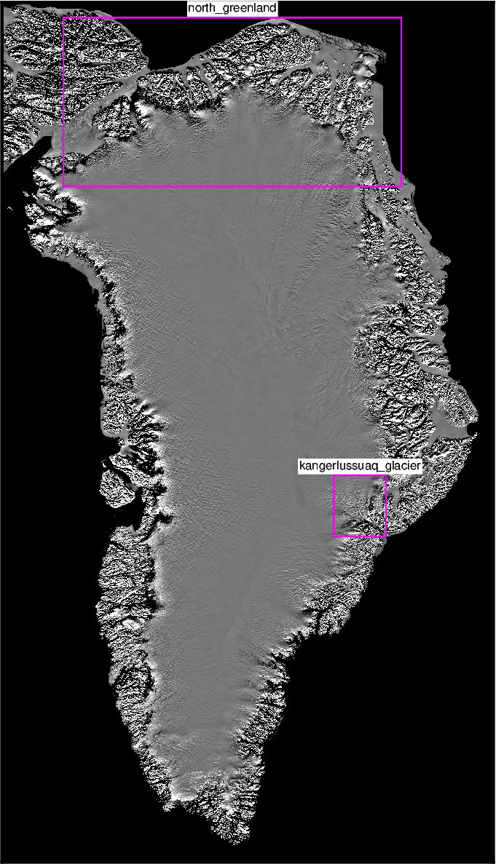
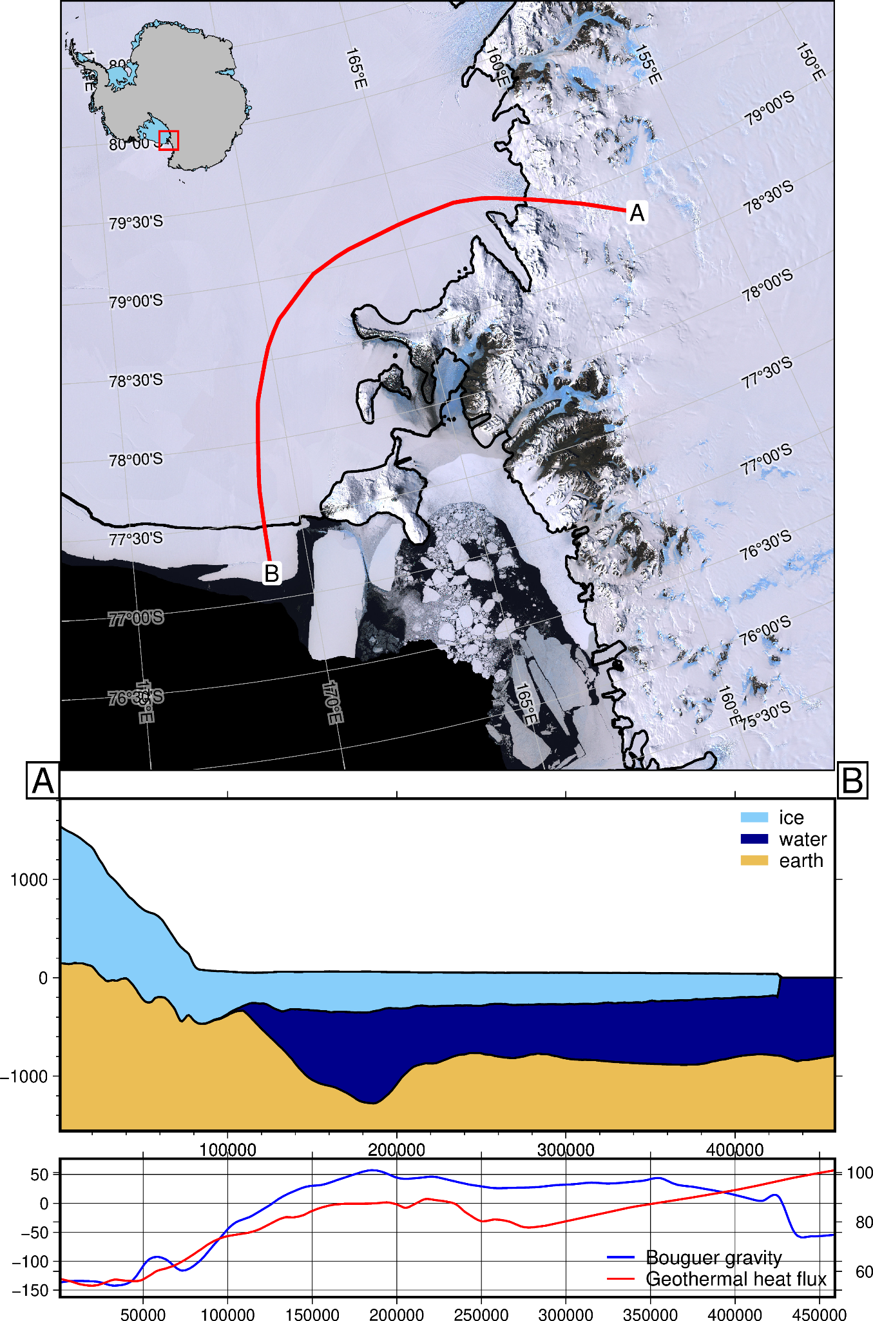
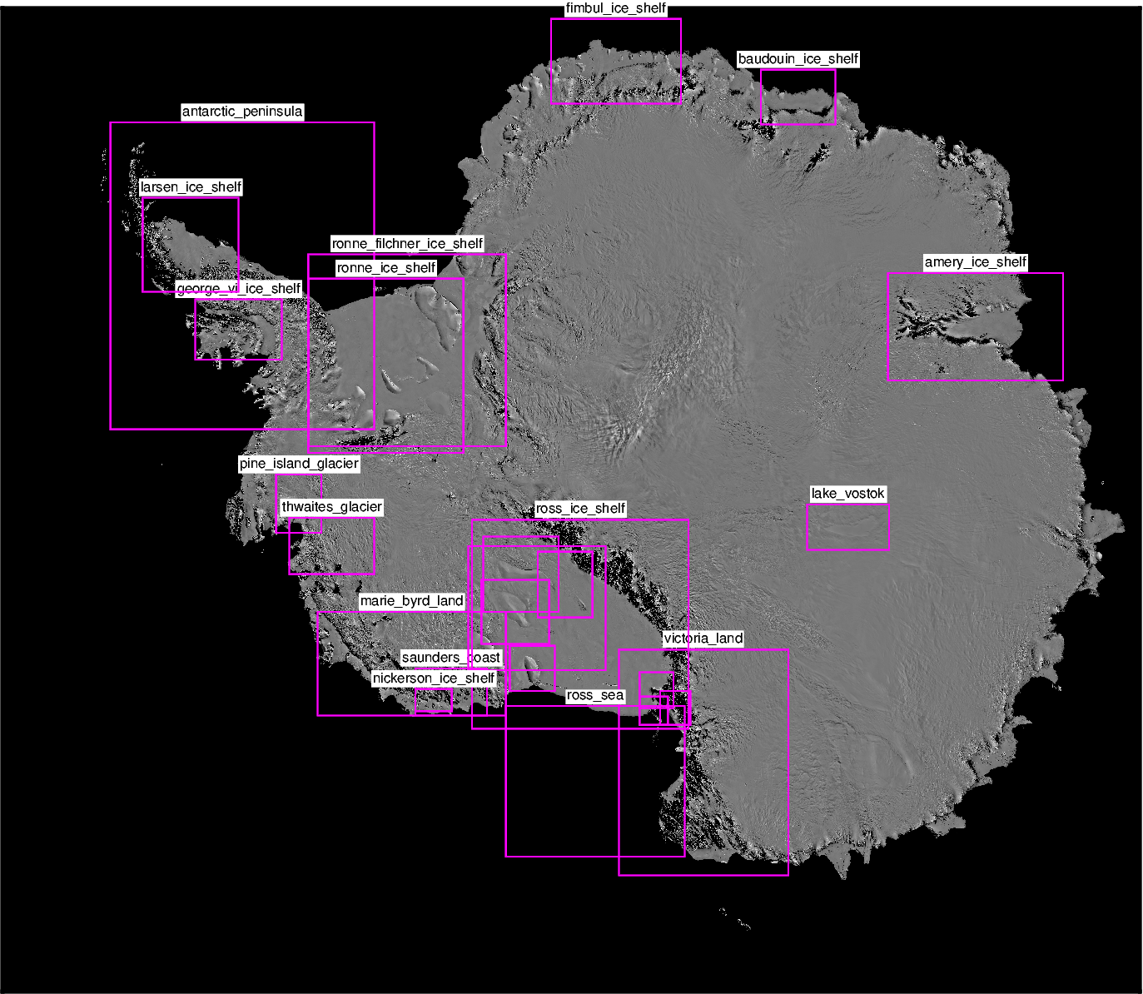

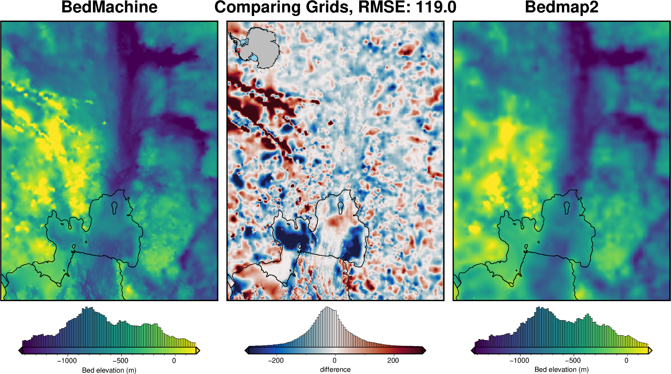
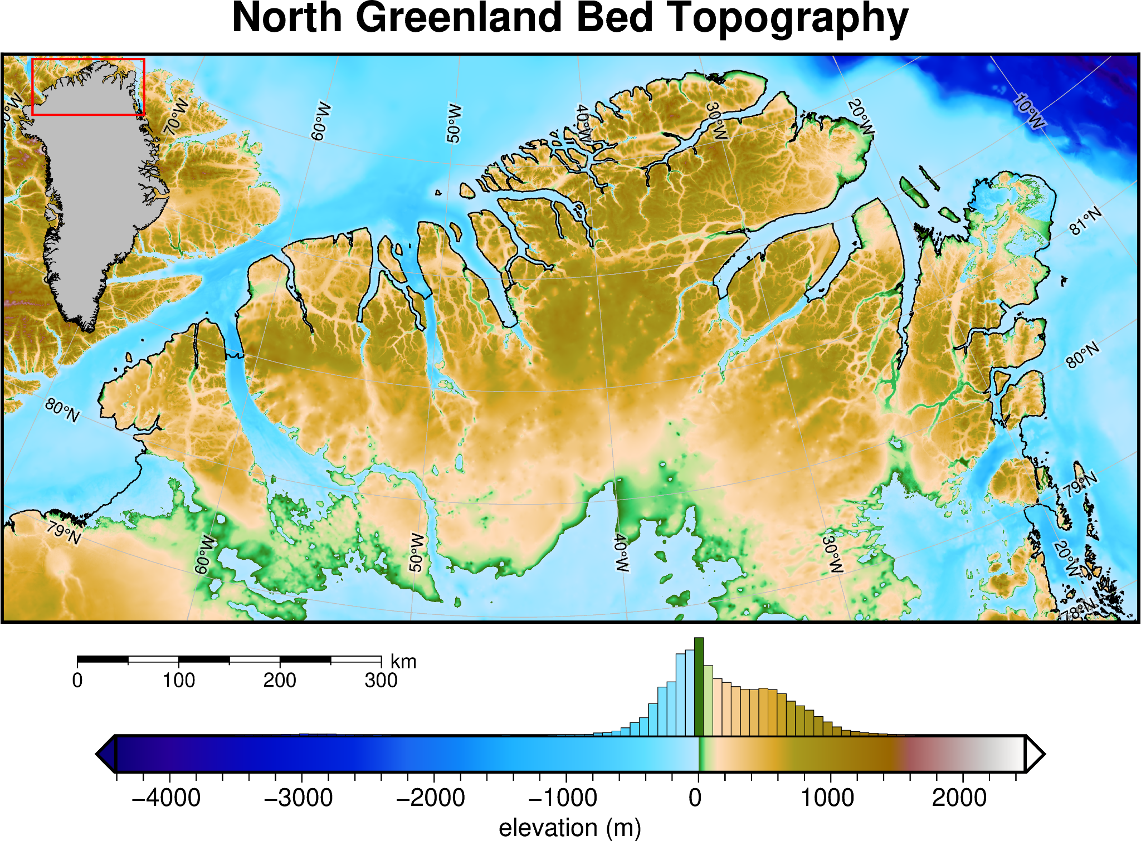
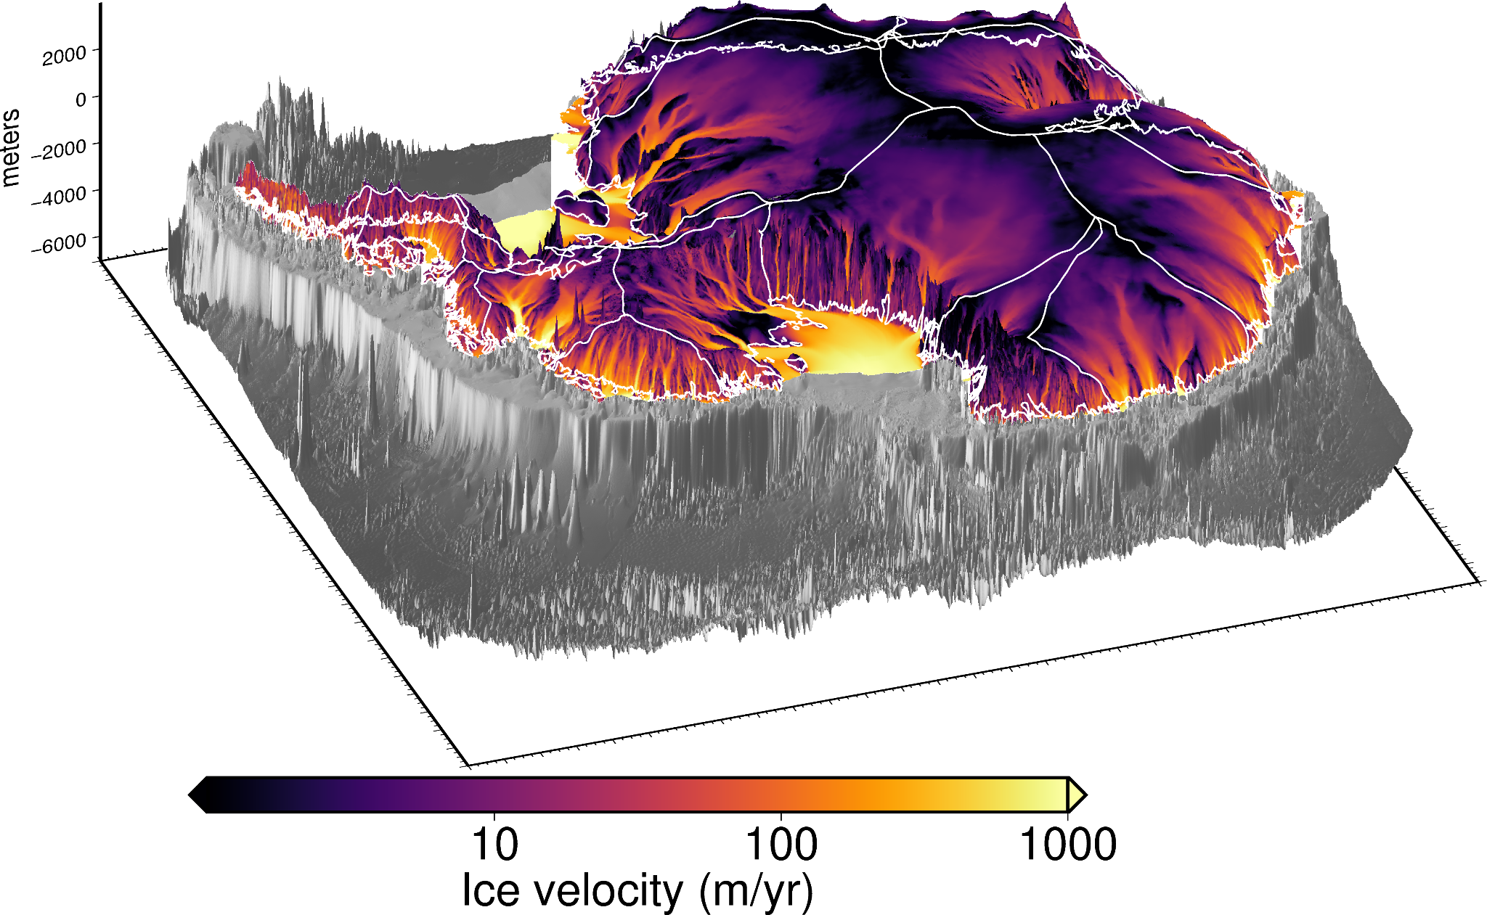


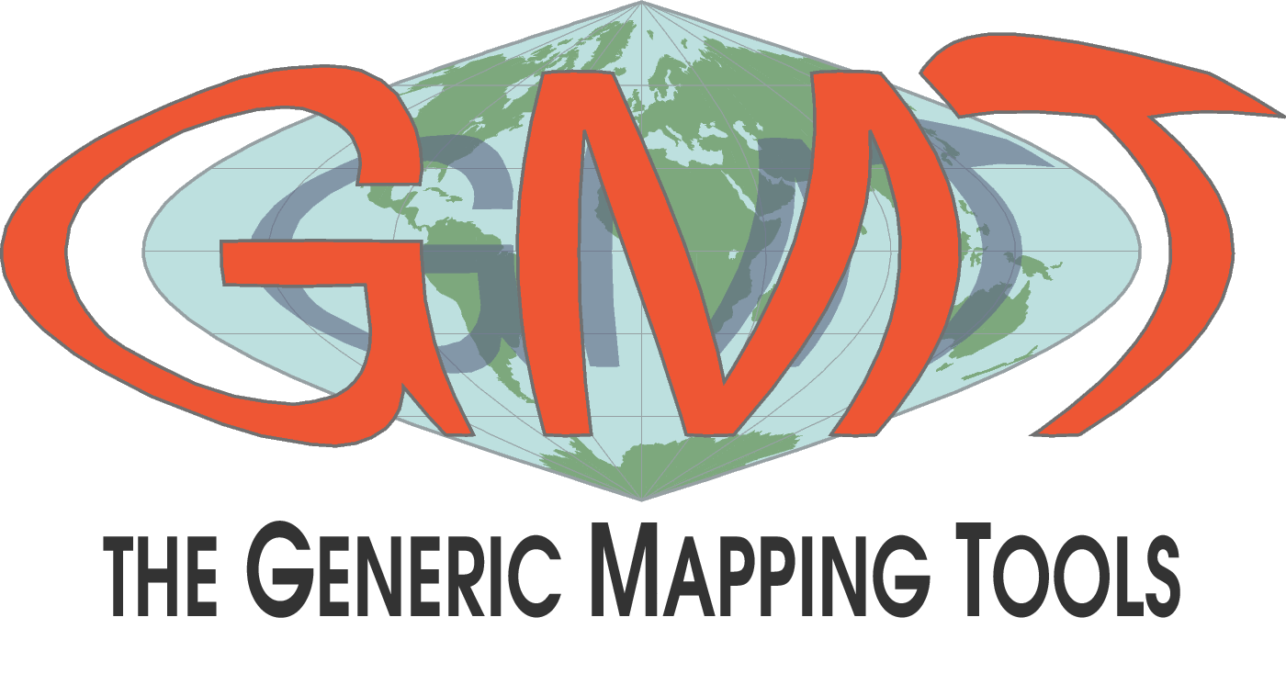
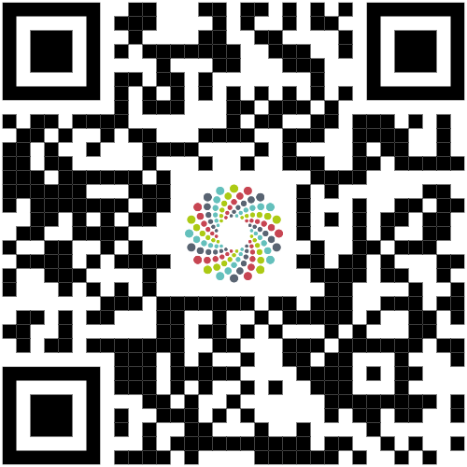



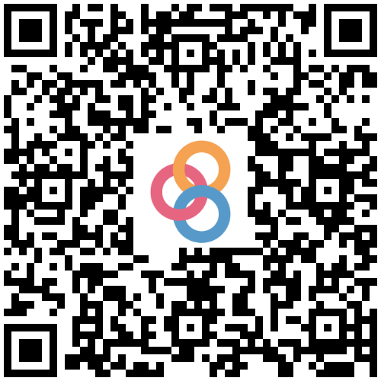
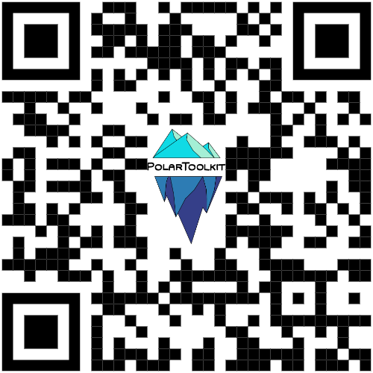

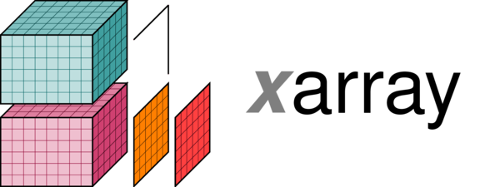


1) from polartoolkit import regions
Pre-defined or interactively chosen geographic regions used in functions throughout, such as subsetting data or specifying areas to plot.
4) from polartoolkit import profiles
Define a line, sample layers & data along it, and plot the results.
3 methods of defining a line:
straight line between 2 points
interactively draw a line
shapefile
# get pre-defined region for Kangerlussuaq Glacier
print(regions.kangerlussuaq_glacier)
>>>(380000.0, 550000.0, -2340000.0, -2140000.0)
Overview
PolarToolkit is a Python package developed to help with conducting science related to Antarctica, Greenland and the Arctic. It consists of 5 modules each providing a unique set of tools to help with a variety of common tasks.
Download polar datasets
Create maps and cross-sections
Perform common geospatial tasks
Streamline your workflow by combining data download, processing, and figure creation all into Python!
2) from polartoolkit import fetch
Easily download and cache data sets to your computer, and perform common raster data manipulations. This module uses Pooch to managed the download, storage, and retrieval of data, and PyGMT for grid manipulations. Below are some of the currently implemented datasets:
Have a dataset you want include?
Add your study region?
Want some additional mapping features?
5) from polartoolkit import utils
Useful functions for common tasks: coordinate conversion, grid comparison, masking, de-trending.
Raise an issue/feature request on GitHub!
Imagery:
LIMA
MODIS MoA and MoG
Topographic data:
BedMachine
Bedmap
REMA
ETOPO
geoid models
IBCSO
Glaciological data:
basal melt
ice velocity
mass or height change
Geophysical data:
gravity
magnetics
geothermal heat flux
glacio-isostatic adjustment
Derived data:
basement topography
crustal thickness
sediment thickness
moho depths
Shapefiles:
GeoMAP faults / outcrops
grounding / coast lines
ice shelf / catchment boundaries
3) from polartoolkit import maps
Create high-quality maps, suplots, and 3D figures using PyGMT with functions specifically tailored to polar settings.
# download and resample data
grid = fetch.bedmap2(
layer = "icebase",
spacing = 10e3,
region = regions.mcmurdo_dry_valleys,
reference = "ellipsoid",
)
# print out grid info
info = utils.get_grid_info(grid, print_info=True)
Try on your phone:
Open a Binder environment
Checkout the website:
Matt Tankersley
matt.d.tankersley@gmail.com
Get the poster!

